Slide 1
Software Process Improvement (SPI)
Presented By
Ms. Sania Yousuf

Slide 2
Process Fundamentals
Process: The means by which people, procedures, and tools are integrated to produce a product (or an end result).
Software Process: The set of all tasks involved in the production and evolution of a software product tasks are organized and sequenced tasked are performed in accordance with a procedure

Slide 3
Software Process Infrastructure
A software process infrastructure can provide process definitions, policies for interpreting and applying the processes, and descriptions of the procedures to be used to implement the processes. Additionally, a software process infrastructure may provide funding, tools, training, and staff members who have been assigned responsibilities for establishing and maintaining the software process infrastructure.
Software process infrastructure varies, depending on the size and complexity of the organization and the projects undertaken within the organization. Small, simple organizations and projects have small, simple infrastructure needs. Large, complex organizations and projects, by necessity, have larger and more complex software process infrastructures.

Slide 4
Software Process Infrastructure (cont.)
Systematic application of software processes and software life cycle models across an organization can provide benefits to all software work within the organization, although it requires commitment at the organizational level.
A common misperception is that establishing a software process infrastructure and implementing repeatable software processes will add time and cost to software development and maintenance.
There is a cost associated with introducing or improving a software process; however, experience has shown that implementing systematic improvement of software processes tends to result in lower cost through improved efficiency, avoidance of rework, and more reliable and affordable software. Process performance thus influences software product quality.

Slide 5
Process Management Principles
The quality of a product is largely determined by the quality of the process used to build it.
By extension, the quality of a software product is largely determined by the quality of the software process used for developing and maintaining it.
To improve the quality of a software product, the process for producing it must improved.
FACT: the majority of software problems or the causes of software crisis (e.g., budget overrun, lack of quality, late delivery) are managerial, not technical (Humphrey 1989)

Slide 6
Examples of Software Crisis and Problems
A review of 17 major DoD software projects revealed that (Humphrey 1993):
Average 28-month schedule was missed by 20 months
One project was not delivered for 7 years
No project was on time
Nine DoD contracts totaling $6.8 million
47% software delivered but never used
29.7% software paid for but never delivered
19% software used but later reworked or abandoned
≈ 3% software could be used after changes
≈ 2% software could be used as delivered

Slide 7
Examples of Software Crisis and Problems (continued)
Industry results are not any better (Gibbs 1994)
For every six new large software systems put into operation, two others are canceled.
Average software project overruns its schedule by half; large projects do worse.
Many projects are terminated after millions of dollars invested, e.g., CONFIRM project (over $200 M), AAS ($144 M), DMV ($44.3 M).
DIA’s Baggage Handling System, delayed for more than a year at $1.1 million/day in interests and operating costs.

Slide 8
Characteristics of Immature Organizations
Processes are generally improvised during the project.
Speciﬁc processes are not followed.
Schedules and budgets are routinely exceeded.
Product quality suﬀers.

Slide 9
Software Process Improvement (SPI)
Software Process Improvement (SPI) methodology is defined as a sequence of tasks, tools, and techniques to plan and implement improvement activities to achieve specific goals such as increasing development speed, achieving higher product quality or reducing costs.

Slide 10
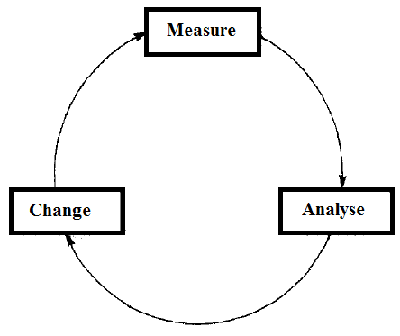
Process Improvement Cycle

Slide 11
Process Improvement Cycle
Process measurement: Process measurement involves the measurement of current project attributes or the product. The aim is to advance the measured attributes as per the goals of the organization involved in process improvement.
Process analysis: It involves the current process is assessed, and process weaknesses and bottlenecks are identified. Process models that describe the process are usually developed during process analysis stage.
Process change: Changes to the process that have been identified during analysis are introduced.

Slide 12
Motivator for SPI
Standardization and Process consistency
Cost Reduction
Competitive Edge
Meeting targets and reduce time to market
Improve customers satisfaction
Job satisfaction, Responsibilities, and Resource Management
Automation and Autonomy
Proven outcome

Slide 13
De-motivators for SPI
Time pressure
Budget Constraints
Staff turnover
Micro Organization
Bad Experience and lack of evidence for direct benefits

Slide 14
Software Process Improvement Models
Objective: to provide a framework for applying process management and quality improvement concepts to software development and maintenance
Examples: Capability Maturity Model (CMM), AMI, SPICE, Bootstrap, Trillium, ISO 9000-3 Standards; also PSP and TSP
Enabling quality improvement is a management responsibility
Quality improvement focuses on ﬁxing processes not people
Quality improvement must be measured
Quality improvement is a continuous process

Slide 15
Capability Maturity Model
Capability Maturity Model is used as a benchmark to measure the maturity of an organization's software process.
It is not a software process model. It is a framework which is used to analyze the approach and techniques followed by any organization to develop a software product.
It also provides guidelines to further enhance the maturity of those software products.
It is based on profound feedback and development practices adopted by the most successful organizations worldwide.
This model describes a strategy that should be followed by moving through 5 different levels.

Slide 16
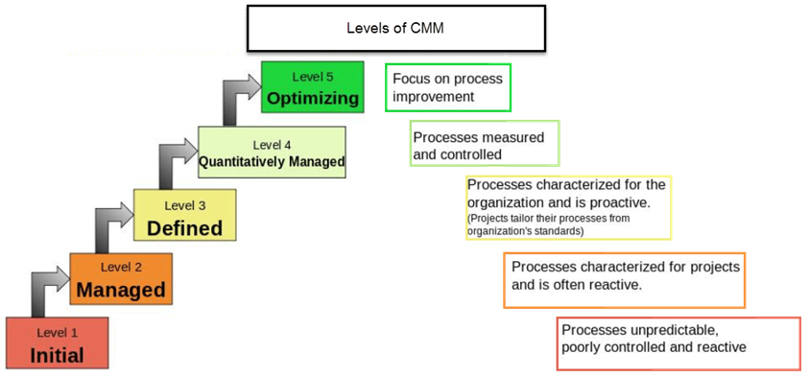
CMM’s Five-Level Framework

Slide 17
Key Process Areas (KPA’s)
KPA’s defines the basic requirements that should be met by a software process in order to satisfy the KPA and achieve that level of maturity.
Conceptually, key process areas form the basis for management control of the software project and establish a context in which technical methods are applied, work products like models, documents, data, reports, etc. are produced, milestones are established, quality is ensured and change is properly managed.

Slide 18
Level-1: Initial
Processes followed are adhoc and immature and are not well defined.
Unstable environment for software development.
No basis for predicting product quality, time for completion, etc.

Slide 19
KPA’s
No KPA’s defined.

Slide 20
Level-2: Repeatable
Focuses on establishing basic project management policies.
Experience with earlier projects is used for managing new similar natured projects.

Slide 21
KPA’s
Project Planning- It includes defining resources required, goals, constraints, etc. for the project. It presents a detailed plan to be followed systematically for successful completion of a good quality software.
Configuration Management- The focus is on maintaining the performance of the software product, including all its components, for the entire lifecycle.
Requirements Management- It includes the management of customer reviews and feedback which result in some changes in the requirement set. It also consists of accommodation of those modified requirements.
Subcontract Management- It focuses on the effective management of qualified software contractors i.e. it manages the parts of the software which are developed by third parties.
Software Quality Assurance- It guarantees a good quality software product by following certain rules and quality standard guidelines while development.

Slide 22
Level-3: Defined
At this level, documentation of the standard guidelines and procedures takes place.
It is a well-defined integrated set of project specific software engineering and management processes

Slide 23
KPA’s
Peer Reviews- In this method, defects are removed by using a number of review methods like walkthroughs, inspections, buddy checks, etc.
Intergroup Coordination- It consists of planned interactions between different development teams to ensure efficient and proper fulfilment of customer needs.
Organization Process Definition- It’s key focus is on the development and maintenance of the standard development processes.
Organization Process Focus- It includes activities and practices that should be followed to improve the process capabilities of an organization.
Training Programs- It focuses on the enhancement of knowledge and skills of the team members including the developers and ensuring an increase in work efficiency.

Slide 24
Level-4: Managed
At this stage, quantitative quality goals are set for the organization for software products as well as software processes.
The measurements made help the organization to predict the product and process quality within some limits defined quantitatively.

Slide 25
KPA’s
Software Quality Management- It includes the establishment of plans and strategies to develop a quantitative analysis and understanding of the product’s quality.
Quantitative Management- It focuses on controlling the project performance in a quantitative manner.

Slide 26
Level-5: Optimizing
This is the highest level of process maturity in CMM and focuses on continuous process improvement in the organization using quantitative feedback.
Use of new tools, techniques and evaluation of software processes is done to prevent recurrence of known defects.

Slide 27
KPA’s
Process Change Management- Its focus is on the continuous improvement of organization’s software processes to improve productivity, quality and cycle time for the software product.
Technology Change Management- It consists of identification and use of new technologies to improve product quality and decrease the product development time.
Defect Prevention- It focuses on identification of causes of defects and to prevent them from recurring in future projects by improving project defined process.

Slide 28
How Maturity Aﬀects Project Results?
Level 1: Initial
Schedule and cost targets are typically overrun.
•
Level 2: Managed
(Repeatable)
Plans based on past performances are more realistic
•
Level 3: Deﬁned
With well-deﬁned processes, performance improves
•
Level 4: Quantitatively
Managed
Based on quantitative understanding of process and product, performance continues to improve
•
Level 5: Optimizing
Performance continuously improves

Slide 29
Case Studies of Applying the CMM
Studies based on 13 organizations (Herbsleb et al 1995)
Organizations involved:
DoD contractors (e.g., Hughes Aircraft)
Commercial organizations (e.g., HP, AT&T, Bull HN, Schlumberger, TI)
Military organizations (e.g., OC–ALC)
Data collected on organizational characteristics, SPI eﬀorts, results of SPI eﬀorts, other elements

Slide 30
Results of Case Studies
Category | Range | Median
Total yearly cost of SPI activities | $49,000–$1.2 M | $245,000
Years engaged in SPI | 1–9 | 3.5
Cost of SPI per software engineer | $490–$2,004 | $1,375
Productivity gain per year | 9%–67% | 35%
Early error detection gain per year | 6%–25% | 22%
Yearly reduction in time to market | 15%–23% | 19%
Yearly reduction in post-release | 10%–94% | 39%
Return-on-investment in SPI | 4.0–8.8 | 5.0

